Slide 1
Yantra Employee Portal Department: ALL Process: Expense Reimbursement Ver 1.0

Slide 2
Engineer

Slide 3
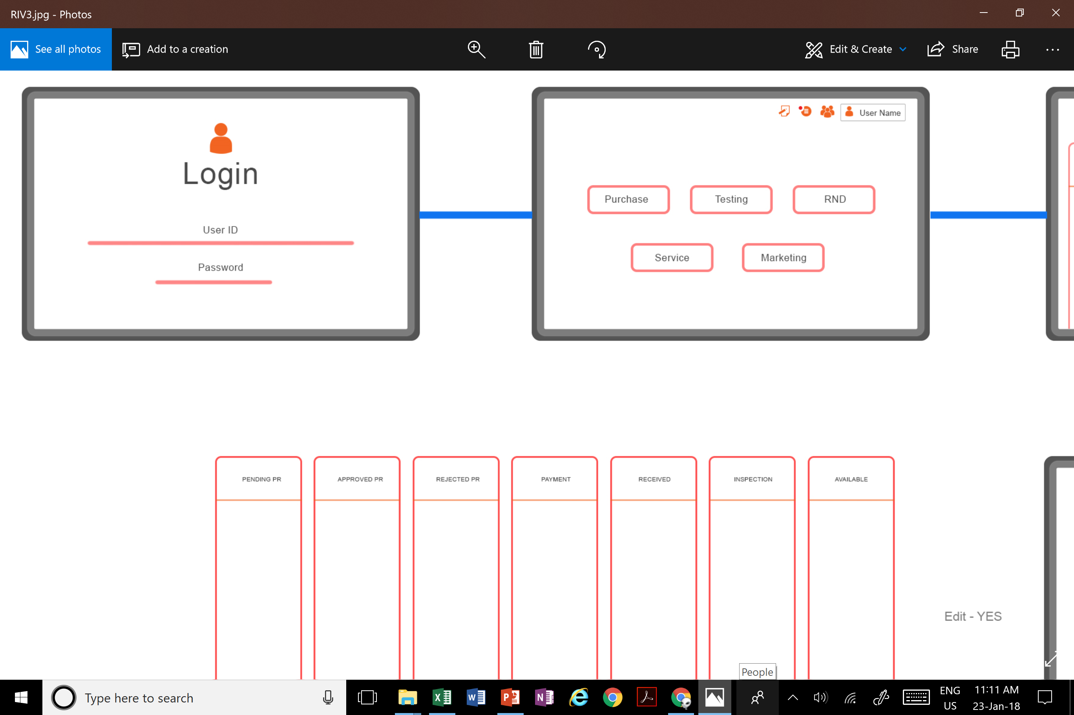
Login

Slide 4

Select Your Department
Sourcing, Inspection & Stores
Testing & Validation
NPD
Product Development
UI/UX/GD Projects
Marketing & Sales
Service
Fin. & Accounts
HR

Slide 5
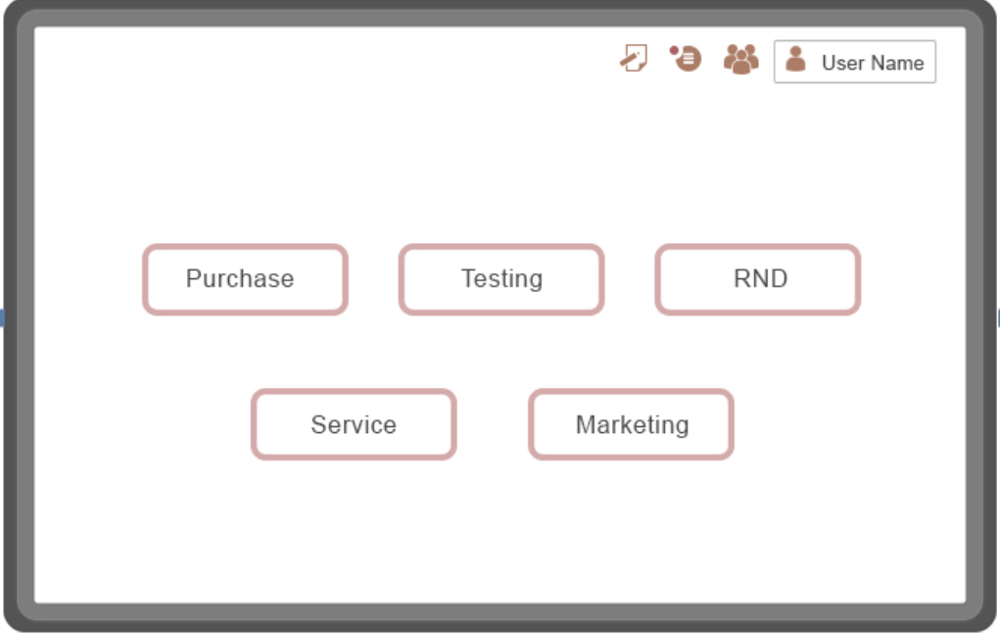

Select Your Department
Sourcing, Inspection & Stores
Testing & Validation
NPD
ERROR:
The department you have selected does not match your profile in the organization. Please select the correct department or contact the IT administrator.
Product Development
UI/UX/GD Projects
Marketing & Sales
Service
Fin. & Accounts
HR

Slide 6
What do you want to do?
Home
Purchase
Purchase
(Create a PR/Check PR Status)
Attendance & Leave
Expenditure & Reimbursement (Log an Expense)
Attendance & Leaves
Expenditure & Reimbursement
Performance Evaluation
Departmental Features
(Access projects)
Performance Evaluation
Departmental Features

Slide 7
What do you want to do?
Home
Purchase
Purchase
(Create a PR/Check PR Status)
Attendance & Leave
Expenditure & Reimbursement (Log an Expense)
Attendance & Leaves
Expenditure & Reimbursement
Performance Evaluation
Departmental Features
(Access projects)
Performance Evaluation
Departmental Features

Slide 8
Expense Reimbursement
Home
Purchase
Create a Travel Plan
Create an Expense
Check Existing Expense Status
Attendance & Leaves
Expenditure & Reimbursement
Performance Evaluation
Check Travel Advance Status
Departmental Features

Slide 9
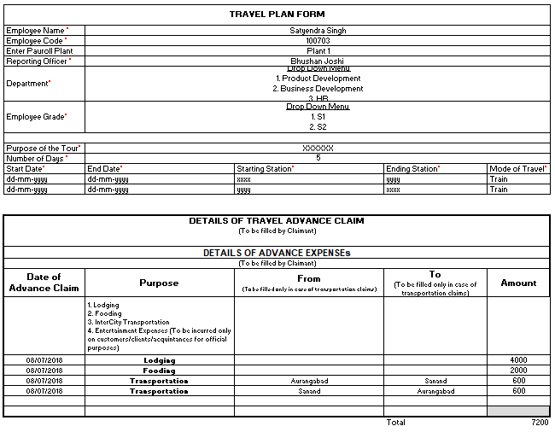

Create a Travel Plan
Home
Purchase
Home
Attendance & Leaves
Purchase
Expenditure & Reimbursement
Create a PR
Create a Travel Plan
Upload All Advance Expenditure Documents
Create an Expense
Check Existing Expense Status
Check Travel
Advance Status
Expenditure & Reimbursement
Performance Evaluation
Performance Evaluation
Departmental Features
Departmental Features
Submit
Preview
Cancel

Slide 10
Create a Travel Plan
Home
Home
Purchase
Home
Purchase
Attendance & Leaves
Purchase
ERROR:
You have either not submitted the details correctly or have not uploaded the required documents. Please complete all the steps to proceed further.
Attendance & Leaves
Expenditure & Reimbursement
Expenditure & Reimbursement
Create a PR
Create a Travel Plan
Upload All Expense Related Documents
Create a Travel Plan
Create an Expense
Create an Expense
Attendance & Leaves
Check Existing Expense Status
Check Existing Expense Status
Check Travel
Advance Status
Expenditure & Reimbursement
Performance Evaluation
Performance Evaluation
Performance Evaluation
Departmental Features
Departmental Features
Departmental Features
Submit
Preview
Cancel

Slide 11
Create a Travel Plan
Home
Home
Purchase
Home
Purchase
Attendance & Leaves
Purchase
SUBMIT EXPENSE – TR-XXXX?
(Kindly Note down the expense number for your own reference)
Attendance & Leaves
Expenditure & Reimbursement
Expenditure & Reimbursement
Create a PR
Create a Travel Plan
Upload All Expense Related Documents
Create a Travel Plan
Create an Expense
Create an Expense
Attendance & Leaves
Check Existing Expense Status
Check Existing Expense Status
Check Travel
Advance Status
Expenditure & Reimbursement
Performance Evaluation
Performance Evaluation
Performance Evaluation
Departmental Features
Departmental Features
Departmental Features
Submit
Preview
Cancel

Slide 12
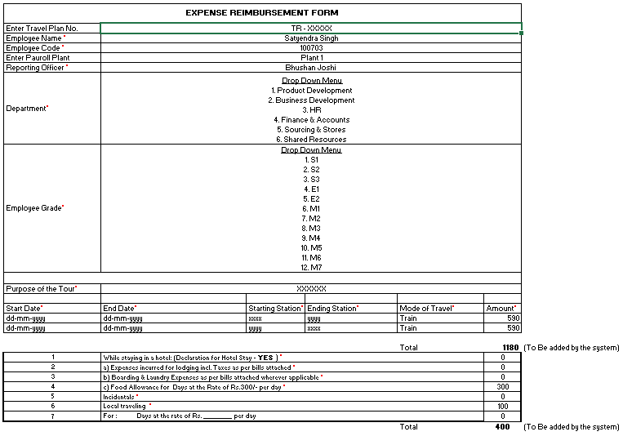
Create a Expense
Home
Home
Purchase
Home
Purchase
Attendance & Leaves
Purchase
Attendance & Leaves
Expenditure & Reimbursement
Expenditure & Reimbursement
*
Create a PR
Create a Travel Plan
Upload All Expense Related Documents
Create a Travel Plan
Create an Expense
Create an Expense
Attendance & Leaves
Check Existing Expense Status
Check Existing Expense Status
Check Travel
Advance Status
Expenditure & Reimbursement
Performance Evaluation
Performance Evaluation
Performance Evaluation
Departmental Features
Departmental Features
Departmental Features
Submit
Preview
Cancel

Slide 13
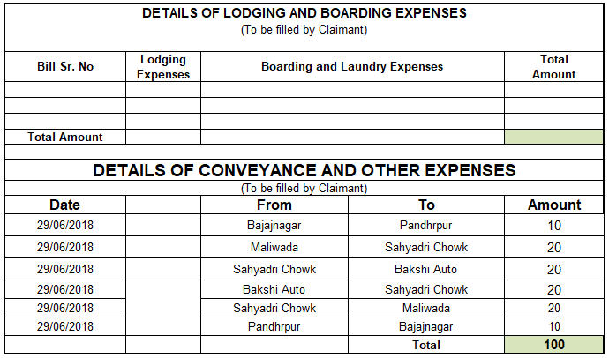

Create an Expense
Home
Home
Purchase
Home
Purchase
Home
Attendance & Leaves
Purchase
Attendance & Leaves
Purchase
Expenditure & Reimbursement
Expenditure & Reimbursement
*
Create a PR
Attendance & Leaves
Create a Travel Plan
Upload All Expense Related Documents
Create a Travel Plan
Create an Expense
Create an Expense
Attendance & Leaves
Check Existing Expense Status
Create an Expense
Check Existing Expense Status
Check Travel
Advance Status
Expenditure & Reimbursement
Check Existing Expense Status
Performance Evaluation
Performance Evaluation
Performance Evaluation
Performance Evaluation
Departmental Features
Departmental Features
Departmental Features
Departmental Features
Submit
Preview
Cancel

Slide 14

Create a Expense
Home
Home
Purchase
ERROR:
You have either not submitted the details correctly or have not uploaded the required documents. Please complete all the steps to proceed further.
Home
Purchase
Home
Attendance & Leaves
Purchase
Attendance & Leaves
Purchase
Expenditure & Reimbursement
Expenditure & Reimbursement
Create a PR
Attendance & Leaves
*
Create a Travel Plan
Upload All Expense Related Documents
Expenditure & Reimbursement
Create an Expense
Create an Expense
Attendance & Leaves
Check Existing Expense Status
Create an Expense
*
Check Existing Expense Status
Check Travel
Advance Status
Expenditure & Reimbursement
Check Existing Expense Status
*
Performance Evaluation
Performance Evaluation
Performance Evaluation
Performance Evaluation
Departmental Features
Submit
Preview
Cancel
Departmental Features
Departmental Features
Departmental Features

Slide 15
Create a Expense
Home
Home
Purchase
SUBMIT EXPENSE – ER-XXXX?
(Kindly Note down the expense number for your own reference)
Home
Purchase
Home
Attendance & Leaves
Purchase
Attendance & Leaves
Purchase
Expenditure & Reimbursement
Expenditure & Reimbursement
Create a PR
Attendance & Leaves
Create a Travel Plan
*
Upload All Expense Related Documents
Expenditure & Reimbursement
Create an Expense
Create an Expense
Attendance & Leaves
Check Existing Expense Status
Create an Expense
*
Check Existing Expense Status
Check Travel
Advance Status
Expenditure & Reimbursement
Check Existing Expense Status
*
Performance Evaluation
Performance Evaluation
Performance Evaluation
Performance Evaluation
Departmental Features
Submit
Preview
Cancel
Departmental Features
Departmental Features
Departmental Features

Slide 16
Create a Expense
Home
Home
Purchase
SUBMIT EXPENSE – ER-XXXX?
(Kindly Note down the expense number for your own reference)
Home
Purchase
Home
Attendance & Leaves
Purchase
Attendance & Leaves
Purchase
Expenditure & Reimbursement
Expenditure & Reimbursement
Create a PR
Attendance & Leaves
Create a Travel Plan
*
Upload All Expense Related Documents
Expenditure & Reimbursement
Create an Expense
Create an Expense
Attendance & Leaves
Check Existing Expense Status
Create an Expense
*
Check Existing Expense Status
Check Travel
Advance Status
Expenditure & Reimbursement
Check Existing Expense Status
*
Performance Evaluation
Performance Evaluation
Performance Evaluation
Performance Evaluation
Departmental Features
Submit
Preview
Cancel
Departmental Features
Departmental Features
Departmental Features

Slide 17
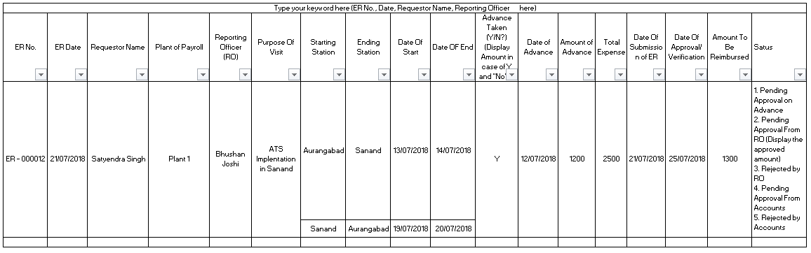
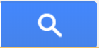
Home
Check Existing Expense Status
Purchase
Home
Attendance & Leaves
Purchase
Expenditure & Reimbursement
Create a PR
Create a Travel Plan
Check Existing PR Status
Create an Expense
Attendance & Leaves
Check Existing Expense Status
Check Travel
Advance Status
Expenditure & Reimbursement
Performance Evaluation
Performance Evaluation
Departmental Features
Departmental Features

Slide 18
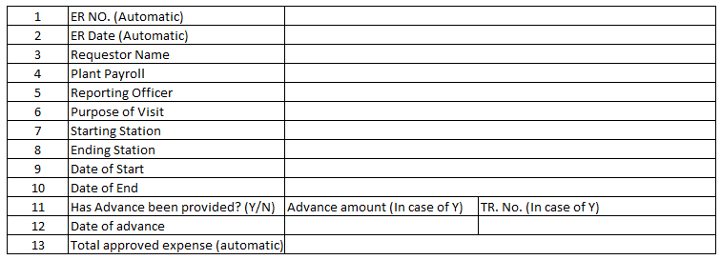
Home
Home
Check Existing Expense Status
Purchase
Purchase
Home
Attendance & Leaves
Attendance & Leaves
Purchase
Expenditure & Reimbursement
Expenditure & Reimbursement
Create a PR
Create a Travel Plan
Create a Travel Plan
Check Existing PR Status
Create an Expense
Create an Expense
Attendance & Leaves
Check Existing Expense Status
Check Existing Expense Status
Check Travel
Advance Status
Check Travel
Advance Status
Expenditure & Reimbursement
Performance Evaluation
Performance Evaluation
Performance Evaluation
Departmental Features
Departmental Features
Departmental Features

Slide 19
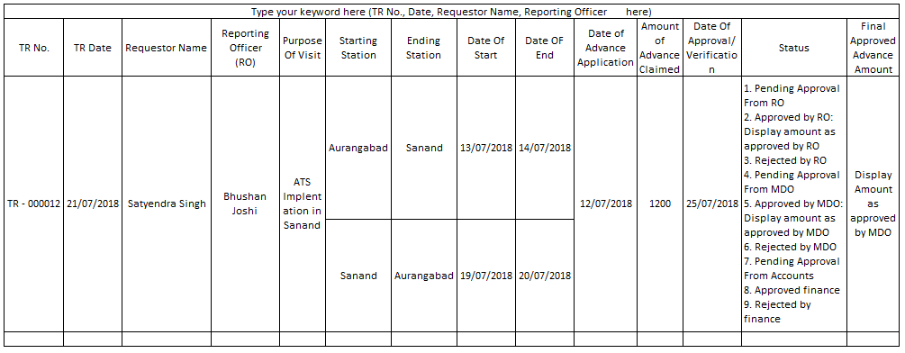
Home
Check Travel Advance Status
Purchase
Home
Attendance & Leaves
Purchase
Expenditure & Reimbursement
Create a PR
Create a Travel Plan
Check Existing PR Status
Create an Expense
Attendance & Leaves
Check Existing Expense Status
Check Travel
Advance Status
Expenditure & Reimbursement
Performance Evaluation
Performance Evaluation
Departmental Features
Departmental Features

Slide 20
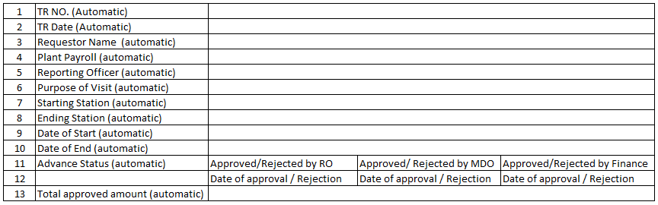
Home
Home
Check Travel Advance Status
Purchase
Purchase
Home
Attendance & Leaves
Attendance & Leaves
Purchase
Expenditure & Reimbursement
Expenditure & Reimbursement
Create a PR
Create a Travel Plan
Create a Travel Plan
Check Existing PR Status
Create an Expense
Create an Expense
Attendance & Leaves
Check Existing Expense Status
Check Existing Expense Status
Check Travel
Advance Status
Check Travel
Advance Status
Expenditure & Reimbursement
Performance Evaluation
Performance Evaluation
Performance Evaluation
Departmental Features
Departmental Features
Departmental Features

